Slide 1

ML Trading Bot
By: Arandi, David, Shay, Tim

Slide 2
Executive Summary:
We effectively created a ML bot that analyzes real time trading data, and gives predictions that are accurate enough to make profitable trades.

Slide 3

Concept
Description: Our objective was to create a ML bot that analyzes real time trading data, and determines the most opportune times throughout the day to buy and sell a stock based on a 5 minute chart.
Motivation: The motivation for our development is based off the desire to utilize a tool to help us make profitable trades passively each day.
User story: This is something we believe both professional and ameteur traders could use to help them achieve their trading goals.

Slide 4

Data Techniques
The data we retrieved came from the Alpacas API.
We chose Alpacas so we could obtain past data to backtest the algorithms, and real time trading data to use for future use.
With the Alpacas API, we were able to grab about 2 months of data at 5 min increments, and use it to create a dataframe for each ticker.

Slide 5

Approach
Technologies: Python, Pandas, Alpacas API, imblearn, pathlib, matplotlib, sklearn, hvplot, pydotplus, IPython.display, finta
Breakdown: 1. Import libraries 2. Create dataframe using alpacas API 3. create variables for EMAs and indicators, and add them to the dataframe 4. Define discrete or continuous features 5. Generate trading signals 6. Create ‘y’ variable for supervised learning algorithm 7. Figure exit price 8. Clean data by removing unwanted zeros from the data frame 9. Train, Test, Split the data 10. Run the data through the random under sampler 11. Run the data through the chosen ML algorithms

Slide 6
Approach Cont.
Challenges:
Dealing with oversampling
Data needed to be balanced
Data gaps
Stock-split affected the price
Figuring out the stops.
Successes:
We were able to solve the oversampling problem using RandomUnderSampling
We were able to balance the data by applying weights
Using ATR for stop loss

Slide 7
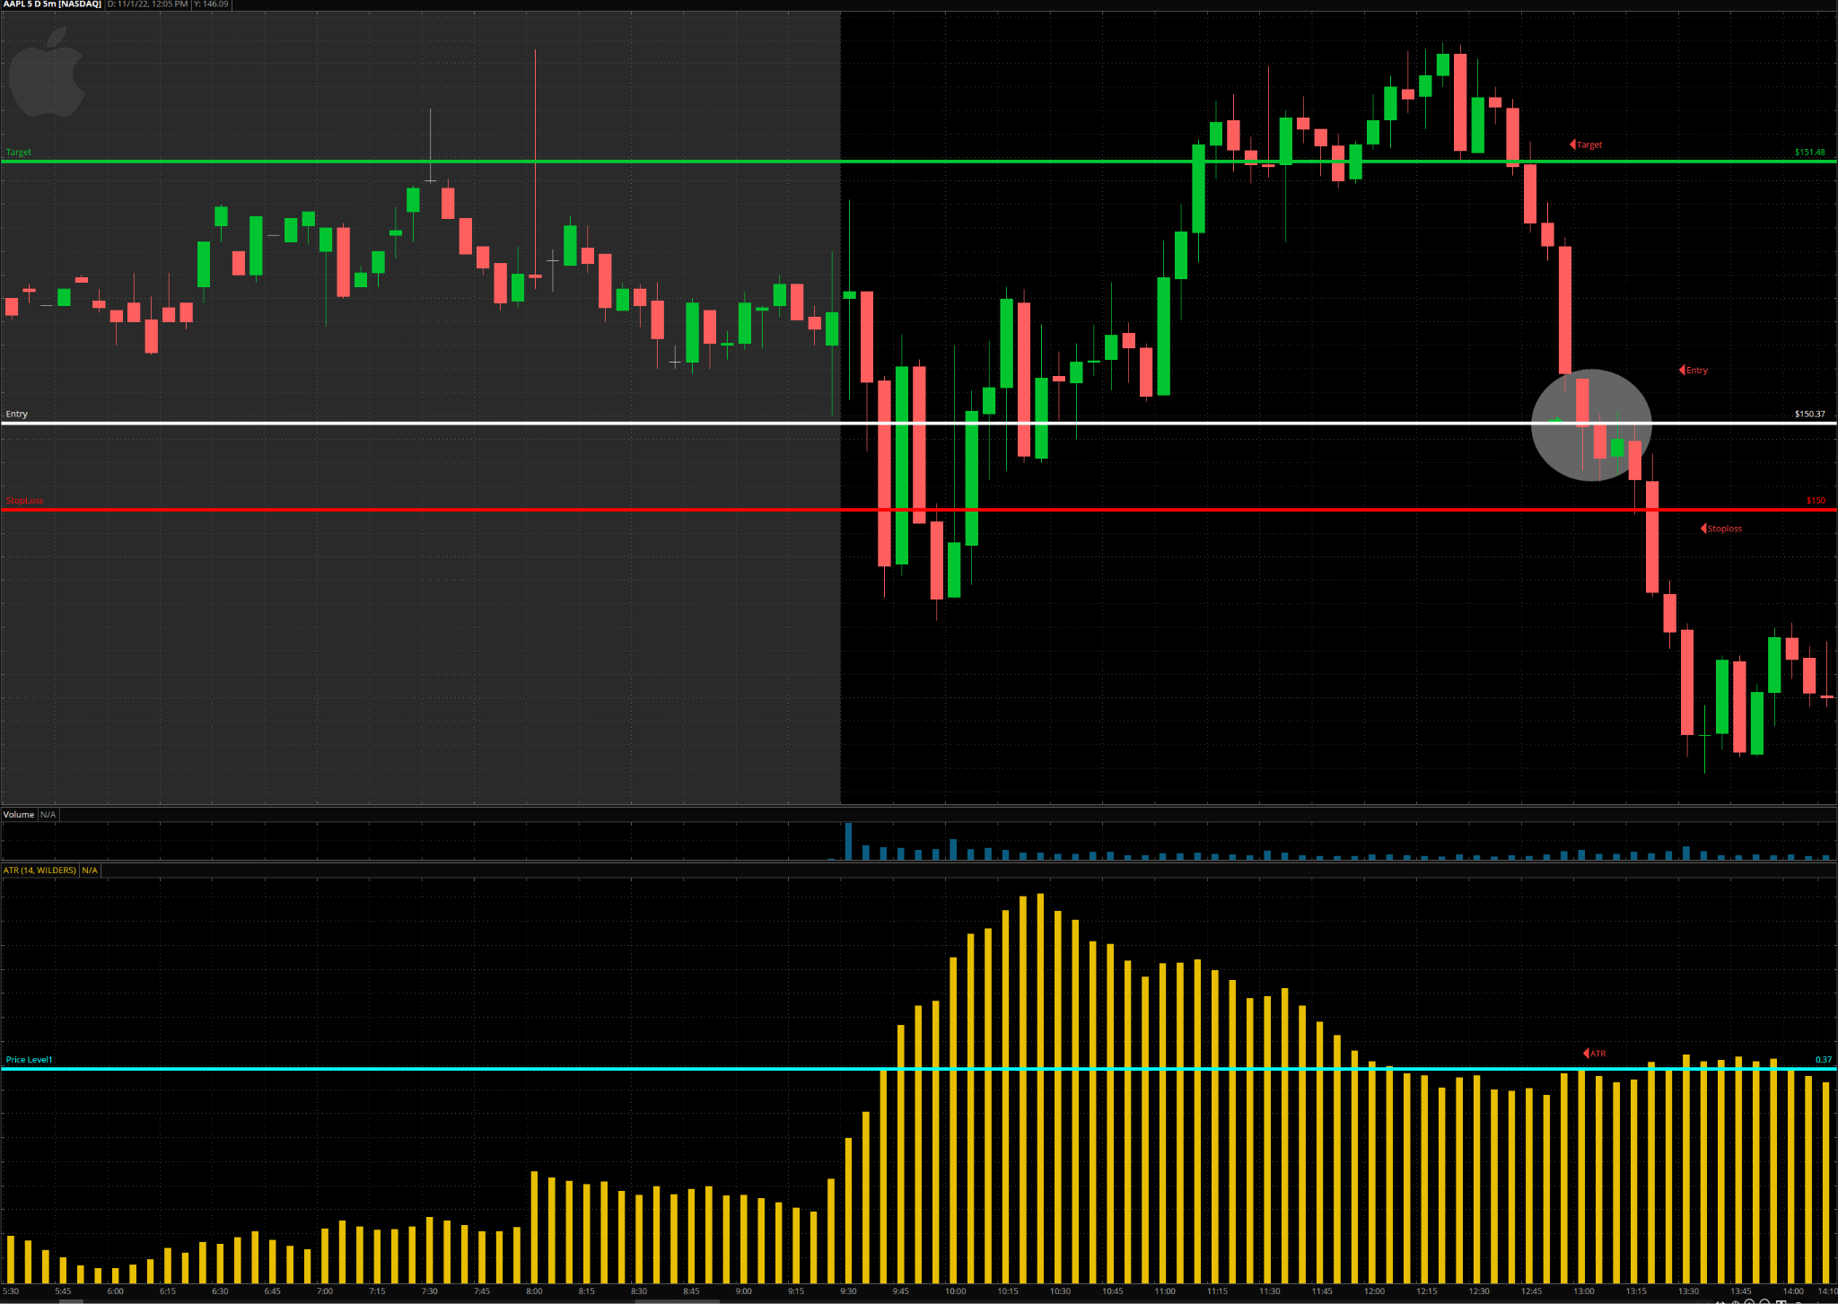
ATR Stops And Targets

Slide 8
Demo

Slide 9
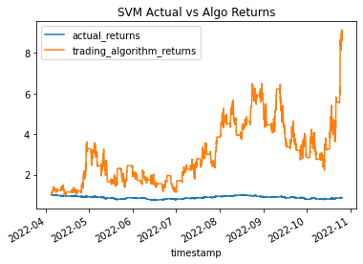
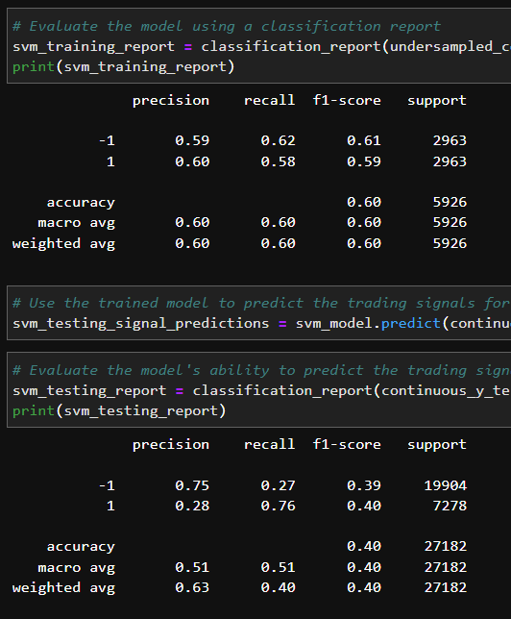
SVM Model

Slide 10
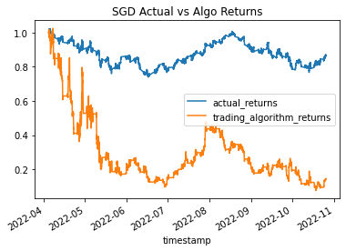
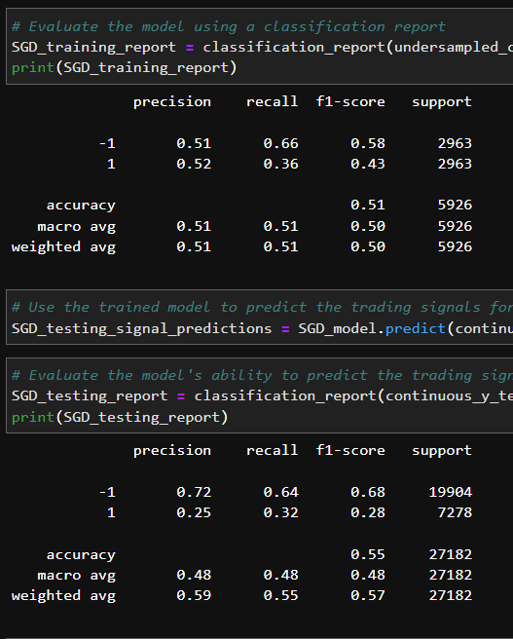
SDG Model

Slide 11
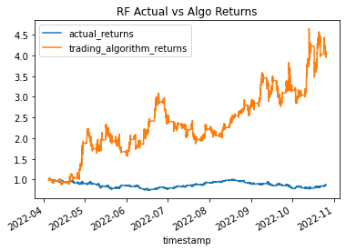
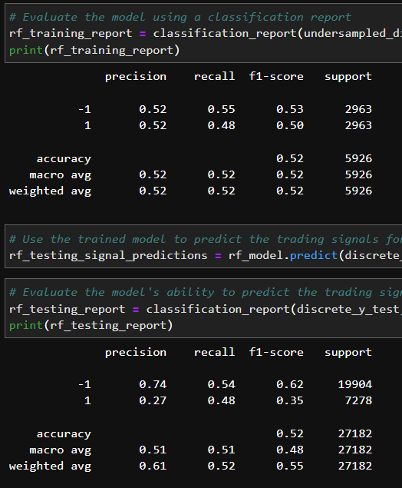
Random Forest Model

Slide 12
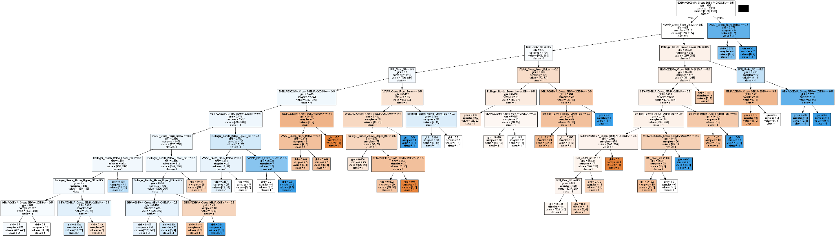
Decision Tree

Slide 13
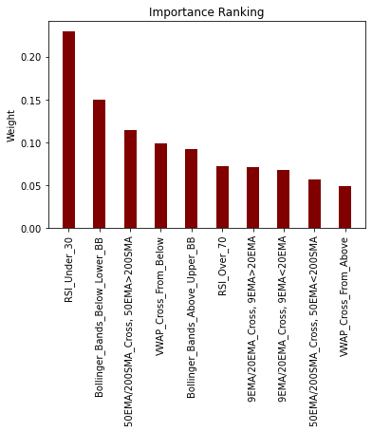
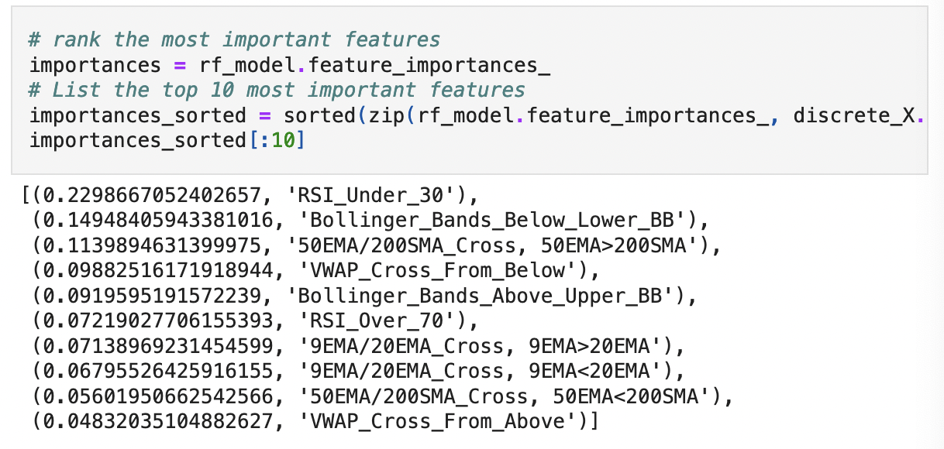
Importance Ranking

Slide 14

Next Steps
Configure the bot to recognize if it should short or long the trade
Analyse the SPY chart to see where the overall market is headed and use that info to help predict whether a short or long position would work better
Apply the code to AWS Sagemaker to automatically make real trades
Apply what we learned about Sagemaker to help us do this
Find an easier way to include multiple tickers simultaneously

Slide 15
Links
GitHub Repo: https://github.com/TimL2/Group_Project_2_ML_Bot

